Slide 1
Lecture 12
Beam search
Tabu search

Slide 2
Beam search
In many problem domains, fairly good heuristic functions can be devised; but they may not be foolproof.
Typically, at various levels a few choices may look almost equal, and the function may not be able to discriminate between them.
In such a situation, it may help to keep more than one node in the search tree at each level.
The number of nodes kept is known as the beam width b.
At each stage of expansion, all b nodes are expanded; and from the successors, the best b are retained.
The memory requirement thus increases by a constant amount.
The search tree explored by beam search of width=2 is shown in next slide figure.

Slide 4
Beam Search is often used in situations where backtracking is not feasible because of other reasons.
One of the places where it has been used often is in speech processing.
The idea is to combine simpler units of sounds, syllables or phonemes, into bigger units.
There are various rules for combining sounds to get meaningful words, and the process has to be done in a continuous (online) mode, producing candidate words as the smaller sound units come in.
Since most languages have words that sound similar, where similar symbols that can combine into different word units, a speech processing system benefits by keeping more than one option open.
Examples are shown in next two slides.
You select the no. of nodes in beam as per the situation.

Slide 5
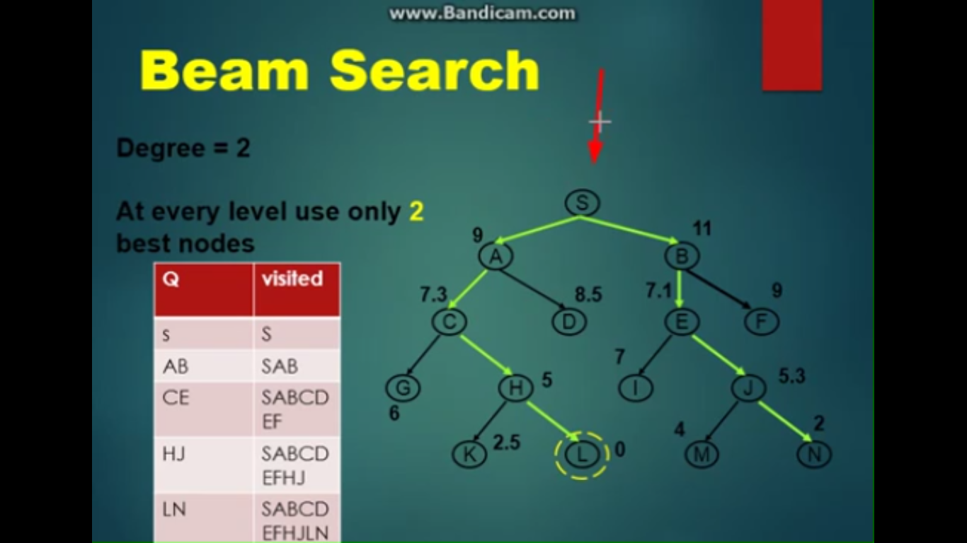

Slide 6
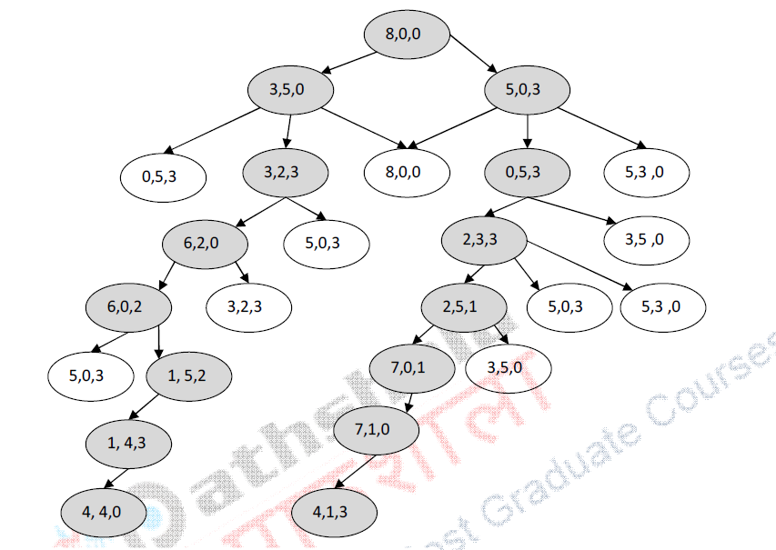

Slide 7
Beam search is better when backtracking is not possible.
In case of two node beam search, whenever one path leads to dead end, the other path is available and we are not stuck up.
We may pick up two most promising children from the other path and can continue as two node beam search once again.
If we have a three node beam search, even when two paths led to dead end, the third path can still save the day.
Thus bigger the beam, more tolerant the search process is.
There are some real world situations which demand such processing.
For example consider the speech to a multi-national audience is being translated to other languages.
So, translation of a sentence into another language can be done with beam search.

Slide 8
Tabu search
The main idea in Tabu search is to augment the exploitative strategy of heuristic search with an explorative tendency that looks for new areas in the search space.
That is, the search follows the diktat of the heuristic function as long as better choices are presented.
But when there are no better choices, instead of terminating the local search as seen so far, it gives in to its explorative tendency to continue searching.
Having got off an optimum, the algorithm should not return to it, because that is what the heuristic function would suggest.
Tabu search modifies the termination criteria.
The algorithm does not terminate on reaching a maximum, but continues searching beyond until some other criterion is met.

Slide 9
One way to getting the most out of the search would be to keep track of the best solution found.
This would be fairly straightforward while searching the solution space.
Tabu search is basically guided by the heuristic function.
As a consequence, even if it were to go beyond a local maximum, the heuristic function would tend to pull it back to the maxima.
One way to drive the search away from the maxima is to keep a finite CLOSED list in which the most recent nodes are stored.
Such a CLOSED list could be implemented as a circular queue of k elements, in which only the last k nodes are stored.
In a solution space search where the moves alter components of a solution, one could also keep track of which moves were used in the recent past.

Slide 10
That is, the solution component that was perturbed recently cannot be changed.
One way to implement this would be to maintain a memory vector M with an entry for each component counting down the waiting period for changing the component.
Barring certain moves in a Tabu search may also exclude some previously unexplored state.
What if one such excluded state is a good one?
One could set an aspiration criterion under which moves could overrule the tabu placed on them.
The criteria could be that all non-tabu moves lead to worse nodes, and a tabu move yields a value better than all values found so far.

Slide 11
Thus, while the tabu principle would try and distribute the search amongst different components equitably, the aspiration criteria would still allow potentially best moves to stay in the competition.
Yet another way to diversify a search could be to keep track of the overall frequency of the different moves.
Note that this can also be done with a finite memory.
Moves that have been less frequently used could be given preference.
Imposing a penalty proportional to the frequency on the evaluation value could do this.
Thus, nodes generated by frequent moves would get evaluated lower and lower, and the other moves would get a chance to be chosen.
Tabu search is a deterministic approach to moving away from maxima.

